Slide 1



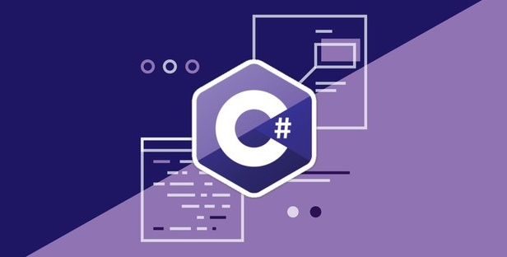
Programming Fundamentals (Extended)
Course Introduction
Programming Fundamentals
SoftUni Team
Technical Trainers
Software University
http://softuni.bg

Slide 2







SoftUni Diamond Partners

Slide 3


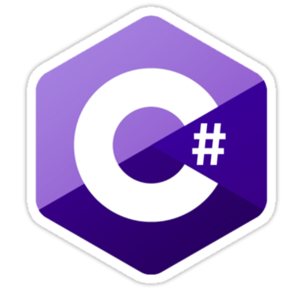
Table of Contents
Course Objectives
Course Program
Trainers Team
Examination
Learning Resources

Slide 4
Questions
sli.do #extended-softuni

Slide 5

Programming Fundamentals - Extended
Course Objectives & Program

Slide 6


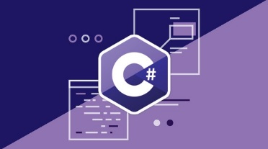
Programming Fundamentals – Course Program
Course Introduction – Course Program, Trainers, Exams, Resources
C# Intro and Basic Syntax
C# Conditional Statements and Loops
Data Types – Numeral Types and Type Conversion
Methods and Debugging – Finding and Fixing Bugs in Programs
Arrays – Simple Array Processing
Lists – Processing Variable Length Sequences
Array and List Algorithms

Slide 7
Programming Fundamentals – Course Program (2)
Dictionaries – Associative Arrays
Advanced Dictionaries – Multi-Dictionaries, Nested Dictionaries
Lambda and LINQ – Collections and Queries
Objects and Simple Classes – Using Objects and Classes, and Defining Them
Files, Directories, Exceptions – Working With the File System and Handling Exceptions
Strings and Text Processing – Processing and Manipulating Text
Regular Expressions – Modern Text Processing
Exam Preparation – Practical Exam Problems (3 times)
Practical Exam – 4 Problems for 6 Hours

Slide 8

Tech Module @ SoftUni
4 Months Technology Fundamentals Training

Slide 9

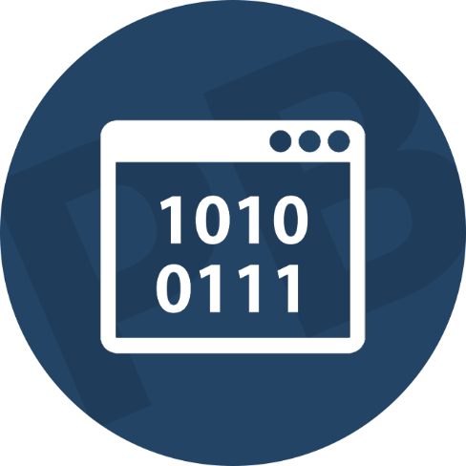

Tech Module Goals
Programming Fundamentals – Extended
4 months programming fundamentals training
3 times weekly, lots of live coding and exercises

Slide 10
Tech Module Goals
Technology Fundamentals
Part I – Programming Fundamentals
Arrays, lists, dictionaries, LINQ, objects, files, strings, regular expressions, …
Part II – Software Technologies
Get acquainted with the most popular technologies out today
PHP Web, JavaScript Web, Java Web, C# Web

Slide 11
Tech Module (Extended) at SoftUni – Timeline
22-May-2017
Aug-2017
Sept-2017
Oct-2017
Nov-2017
Programming Fundamentals Extended
Lessons + exercises + exam
12 weeks * 3 times / week
6 credits
Start: 22-May-2017
Final exam: 20-Aug-2017
Programming Fundamentals Re-Take Exams
First week of Sept-2017
Programming Fundamentals
Lessons + exercises + exam
7 weeks * 5 times / week
6 credits
Start: September 2017
Final exam: October 2017
Software Technologies
Lessons + exercises + team work project
5 weeks * 5 times / week
12 credits
Start: October 2017
Final Exam: November 2017

Slide 12
Professions @ SoftUni
Programming Basics
Java
Fund.
Java
DB
Java
Web
JS Core
C#
Fund.
C#
DB
C#
Web
JS Core
Programming Fundamentals Extended
Tech Module
JS Core
MEAN
Stack
Web
Basics
PHP
Web
Web
Basics
JS Core
https://softuni.bg/curriculum
https://softuni.bg/trainings/courses

Slide 13

The Trainers Team

Slide 14
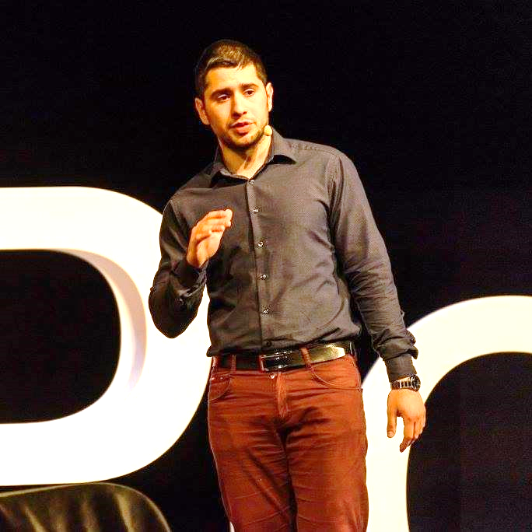
Trainers Team
Preslav Mihaylov
Technical Trainer @ Software University
Top performing student from the Software University
Embedded Software Engineer
Web site & blog: www.pmihaylov.com

Slide 15
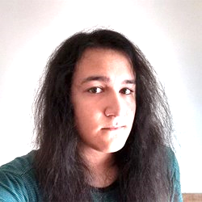
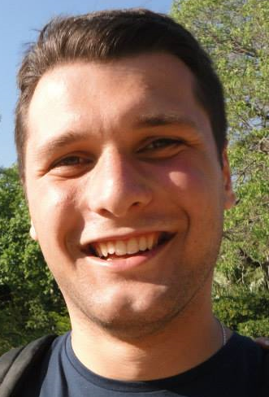
Trainers Team
Vladimir Damyanovski
Junior Trainer @ SoftUni
Interested in programming and electronic music
Kalin Primov
Junior Trainer @ SoftUni
Interested in Java, C# and JavaScript

Slide 16
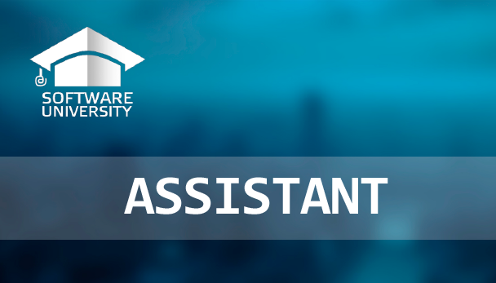
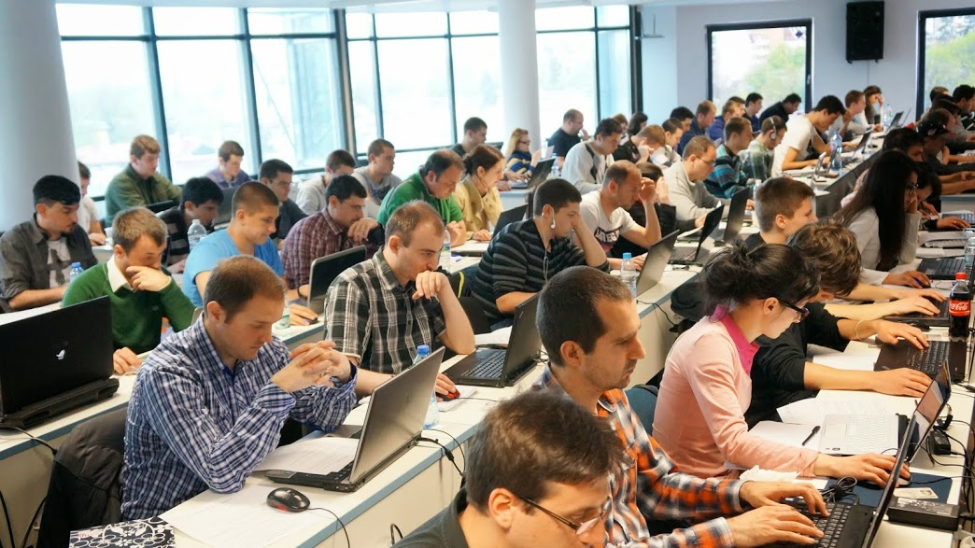
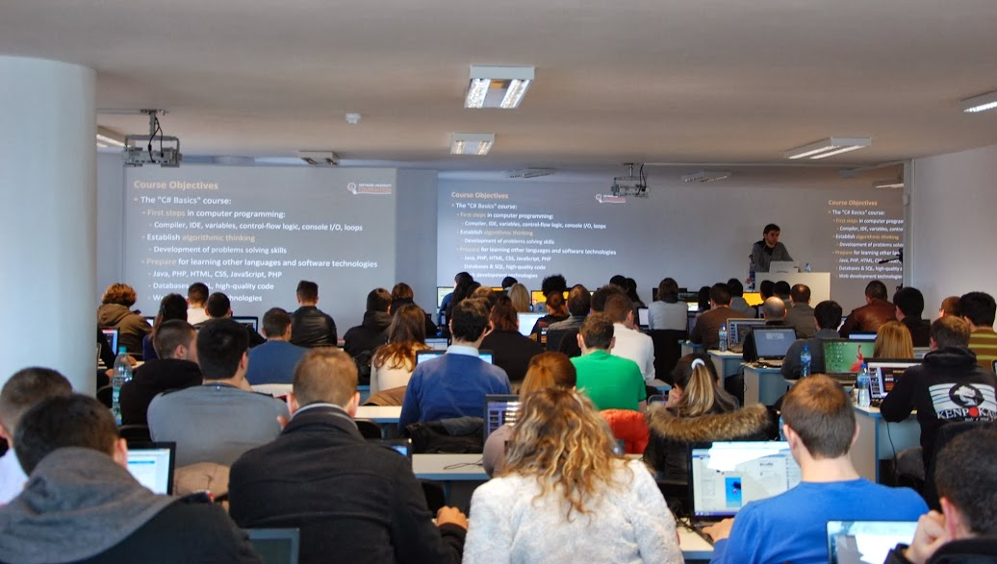
Teaching Assistants
Teaching assistants
Scholarship top students from SoftUni
Yanitsa Valeva, Radoslav Evgeniev

Slide 17

Programming Fundamentals: More Details
Duration, Languages, Technologies

Slide 18


Training Duration – Programming Fundamentals
Lectures: ~60 hours (onsite + videos)
Practical exercises (in class): ~100 hours
Exam preparation: 3*4 hours
Exam: 6 hours
Schedule: May – August 2017
Exam date: 20 August 2017

Slide 19



Why English?
Why the slides are in English?
English is the native language of the software engineers
Specific terminology should be in English
Translations are inaccurate and funny
Just learn English!
No excuses

Slide 20
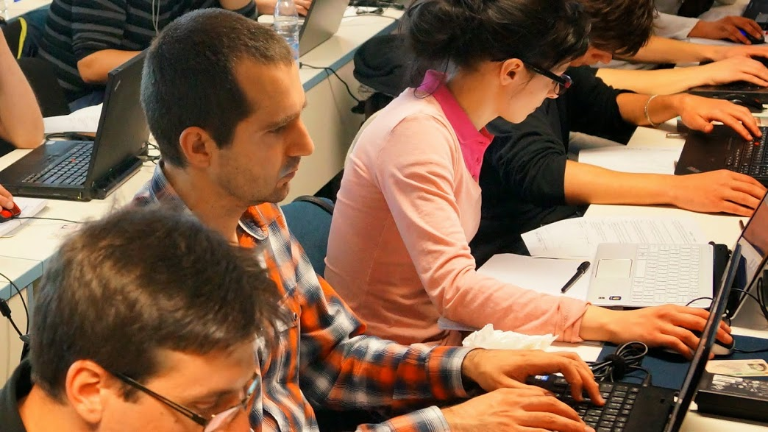


Programming Fundamentals
Evaluation Criteria

Slide 21


Scoring System for “Programming Fundamentals”
Exam – 90%
Homework (exercises) – 10%
Bonuses: up to 10%
Presence in class: 5% (onsite students only)
Forum activities
Others

Slide 22
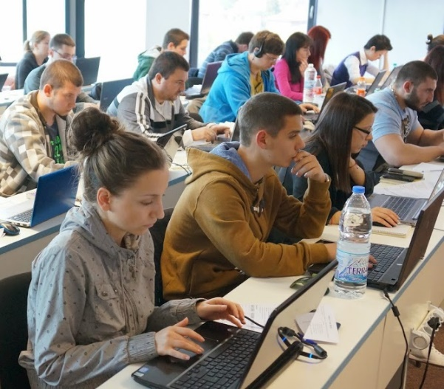

Programming Fundamentals Exam
Practical programming exam
4 practical problems for 6 hours
Simple arrays, lists, dictionaries, strings
Code in C# (Java, PHP, JS are also welcome)
Automated judge system
http://judge.softuni.bg
Solutions are evaluated for correctness only
Code quality is still not measured

Slide 23

Homework Assignments
Doing your homework is very important!
Programming can only be learned through a lot of practice!
You should write code every day!
Each lecture is followed by many exercises
Try to solve them in class
The rest are your homework
Homework assignments are due in 6 days after each lecture
Submission through our online judge system: judge.softuni.bg

Slide 24





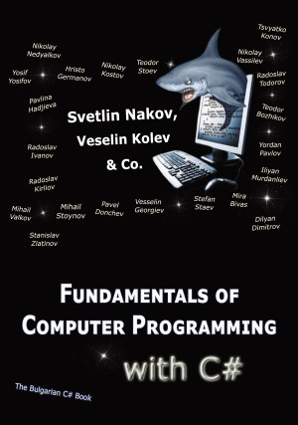




Resources
What We Need Additionally?

Slide 25
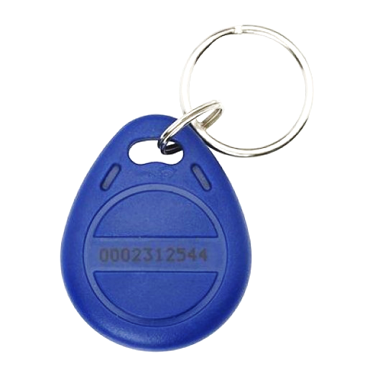
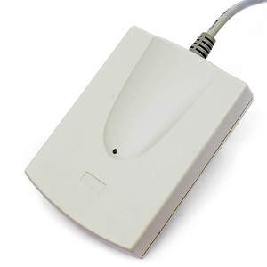
Your RFID Chip
Students can either
Take RFID chip from SoftUni
Or use their own chip / card
Register your chip number in your SoftUni profile: https://softuni.bg/users/profile/show
Check-in at the reception every time when you come
See your last visits in your profile: https://softuni.bg/users/profile/show

Slide 26

Course Web Site & Forums
The Programming Fundamentals official web site:
Register for the "Software University Forum":
Discuss the course exercises with your colleagues
Find solutions for all course exercises
Share source code / discuss ideas / help each other
https://softuni.bg/courses/programming-fundamentals/
https://softuni.bg/forum/categories/44/

Slide 27
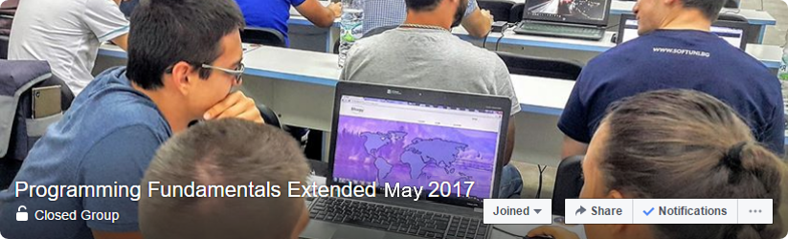

Facebook Group
Programming Fundamentals Extended May 2017 Facebook Group:
https://www.facebook.com/groups/prog.fund.ext.may.2017/
Post questions, problem solutions, tips and tricks, etc…
Discussion is very encouraged!

Slide 28



Programming Fundamentals Slides and Videos
All lecture slides, videos, homework assignments, projects and other resources are open content, available for free
Visit the course web site to access the course resources

Slide 29
The Free C# Fundamentals Textbook
Partial textbook for the course:
"Fundamentals of Computer Programming with C#", by Svetlin Nakov & Co., 2013, ISBN 9789544007737
English and Bulgarian versions (as PDF, ePub, …)
Freely downloadable from: www.introprogramming.info
The C# Programming courses @ SoftUni.bg partially follows the book
Programming Fundamentals → chapters 2, 3, 7, 9, 11, 13, 14, 16, 18, 22

Slide 30

Software University Learning System (SULS)
Software University Learning System (SULS)
www.softuni.bg
Important resource for students
Homework submissions
Homework check-up
Exams and results
Reports about your progress

Slide 31


Required Software
Software needed for this course:
Microsoft Windows (Win 10 / 8.1 / Win8 / Win7) or Mac or Linux
Visual Studio Community 2017 (a free version of VS 2017)
Older versions are acceptable, but not recommended
Alternative: MonoDevelop (for Linux / old Windows)

Slide 32
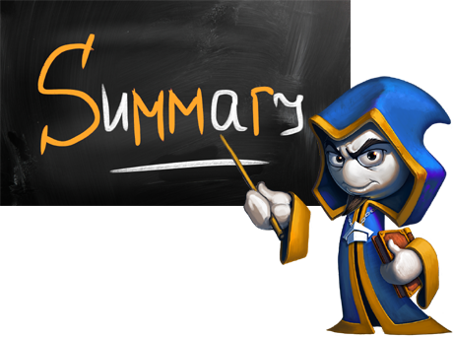

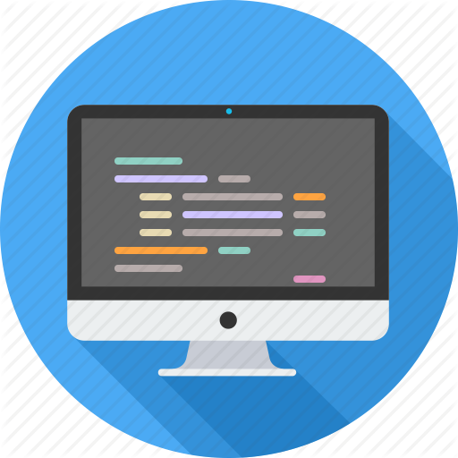

Summary
Training program
Data types, methods, debugging, arrays and lists, dictionaries, objects, strings and much more
Practical exam
4 problems for 6 hours
Learning resources
Slides, videos, software, books, forum

Slide 33
Programming Fundamentals – Course Intro
https://softuni.bg/courses/programming-fundamentals

Slide 34
License
This course (slides, examples, demos, videos, homework, etc.) is licensed under the "Creative Commons Attribution-NonCommercial-ShareAlike 4.0 International" license

Slide 35



Trainings @ Software University (SoftUni)
Software University – High-Quality Education, Profession and Job for Software Developers
softuni.bg
Software University Foundation
softuni.org
Software University @ Facebook
facebook.com/SoftwareUniversity
Software University Forums
forum.softuni.bg

